Slide 1
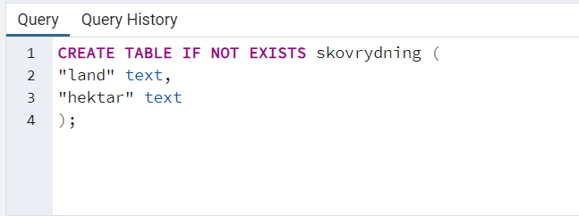
Datatypen er text da CSV benytter ""

Slide 2
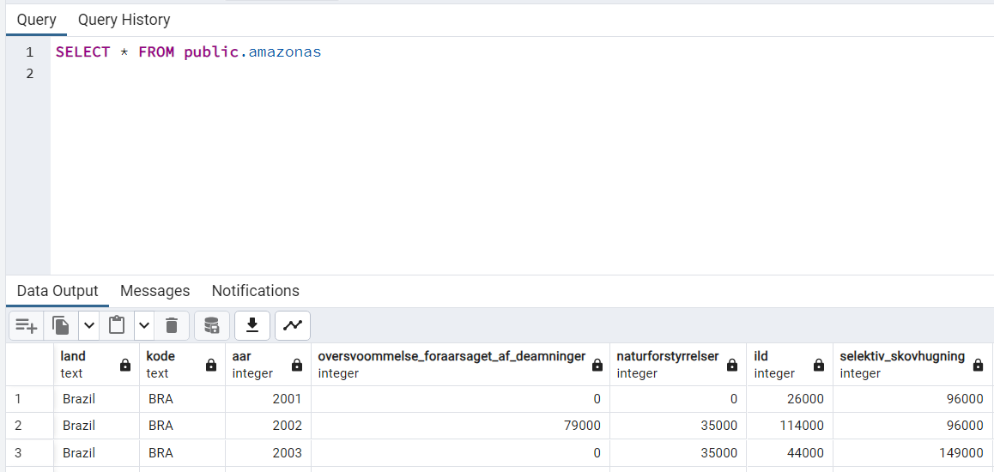

Slide 3
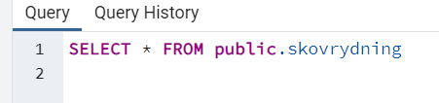
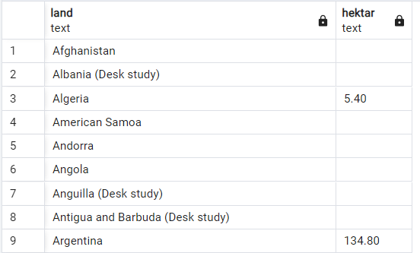

Slide 4
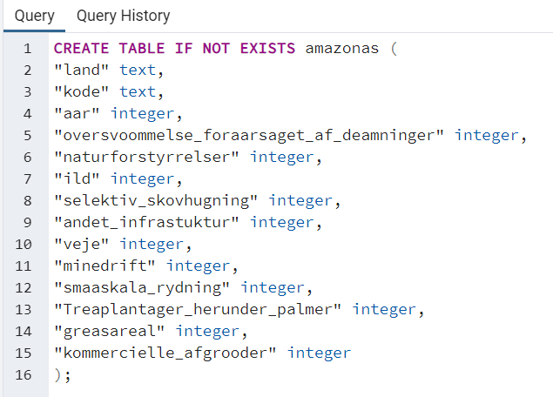

Slide 5
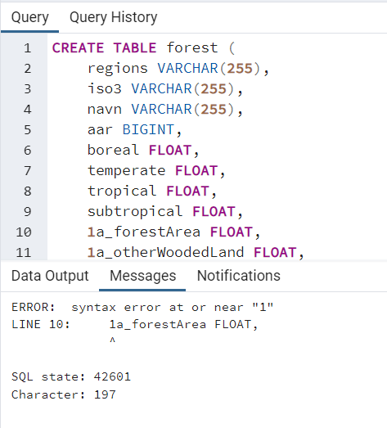
Fejler fordi det ikke er "" om kolonne navne.

Slide 6
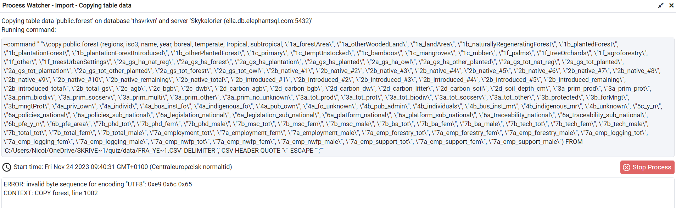
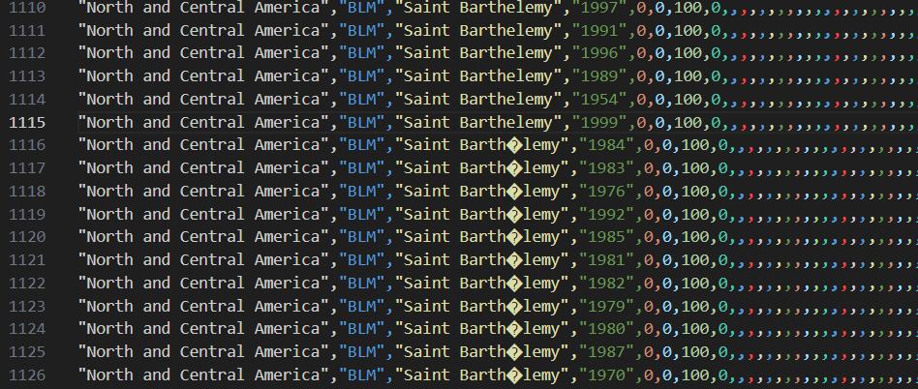
? Er et é som vi har ændret til e. i csv´en

Slide 7
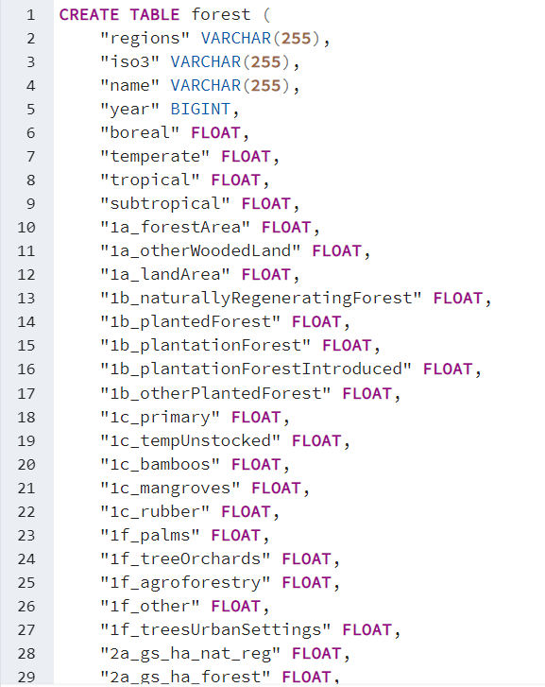
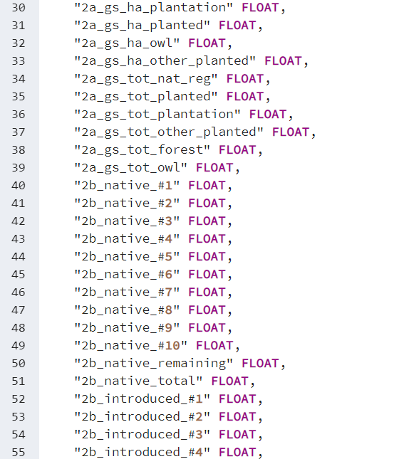
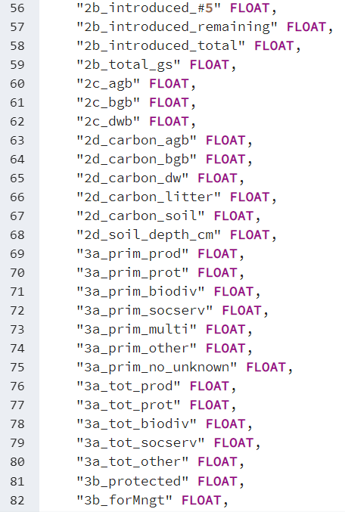

Slide 8
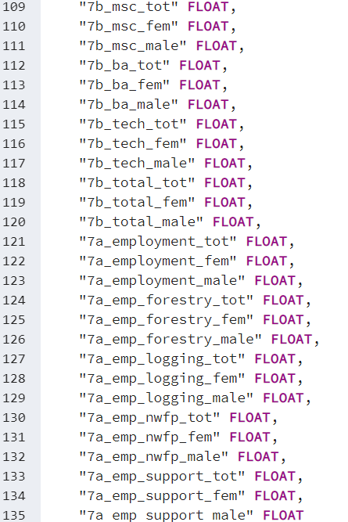

The FLOAT data type in SQL is used for columns that need to store floating-point numbers. These are numbers that have a decimal point and can represent a wide range of values, including very small and very large numbers. The key characteristics of the FLOAT data type are:
Precision: A FLOAT data type can represent numbers with significant digits both before and after the decimal point. The precision (i.e., the number of significant digits) is platform-dependent, typically offering at least 15 significant digits.
Storage Size: The storage size of a FLOAT is typically less than that of a DECIMAL or NUMERIC type with the same number of digits. However, this smaller size comes at the cost of precision and can lead to rounding errors in calculations.
Use Cases: It's ideal for scientific calculations, measurements, or any scenario where the exact precision is not crucial but a wide range of values needs to be accommodated. For example, storing values like 3.14159, 0.0001234, or 123456789.12345.
Rounding Errors: Due to the way floating-point numbers are represented in memory, certain calculations can introduce small rounding errors. This is an inherent issue with floating-point arithmetic in most programming and database environments, not just SQL.
Alternatives: For use cases requiring precise decimal arithmetic (like financial calculations), SQL provides other data types like DECIMAL or NUMERIC, where the precision and scale (number of digits after the decimal point) are explicitly defined.
In your CSV file, columns inferred as float64 in pandas were mapped to FLOAT in SQL, implying that these columns contain or can contain floating-point numbers. If you need precise control over the number of digits after the decimal point, you might consider using DECIMAL or NUMERIC types instead, specifying the required precision and scale.

